Slide 1
Unit 1: Historical Understanding
Mr. Matthews

Slide 2
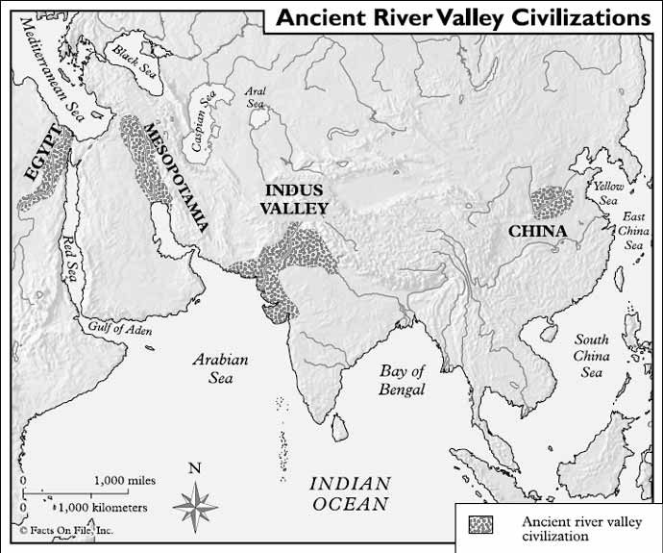
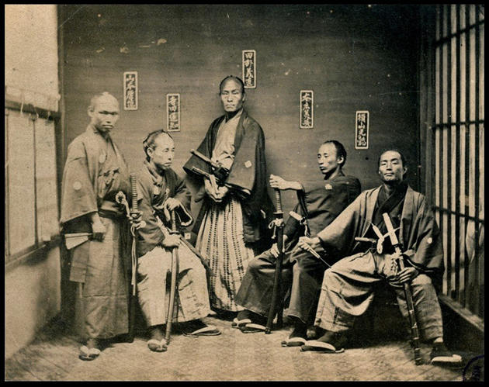
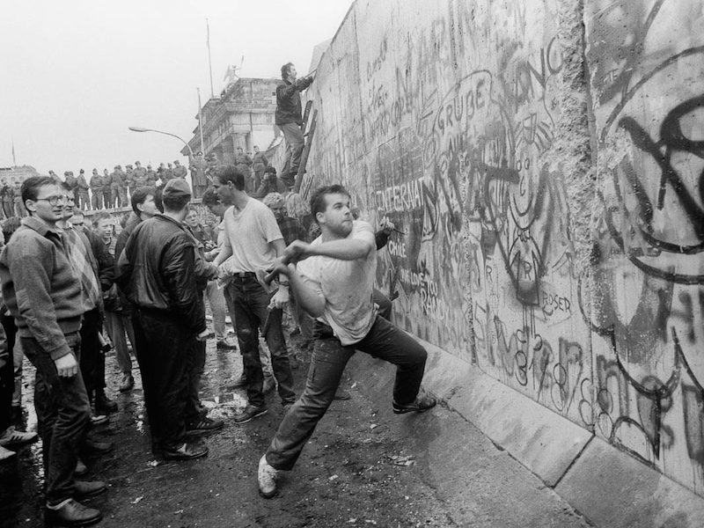
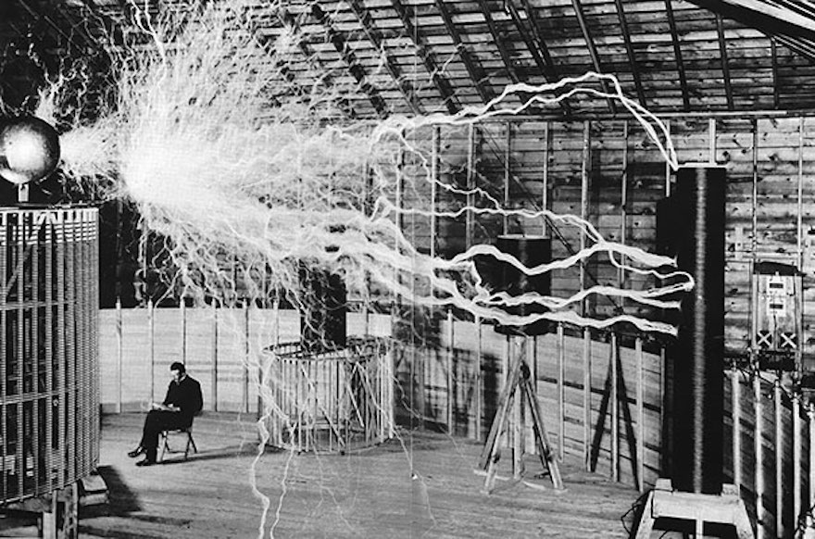
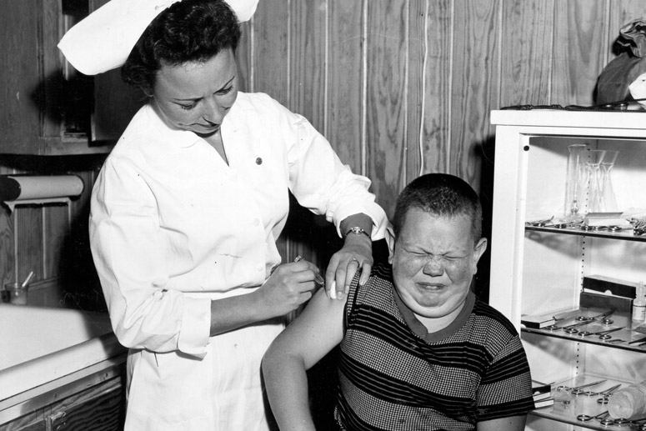
Why must we learn history?

Slide 3
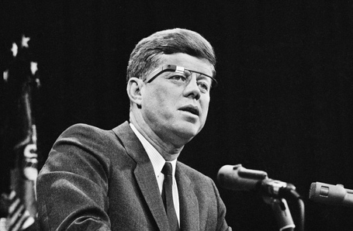
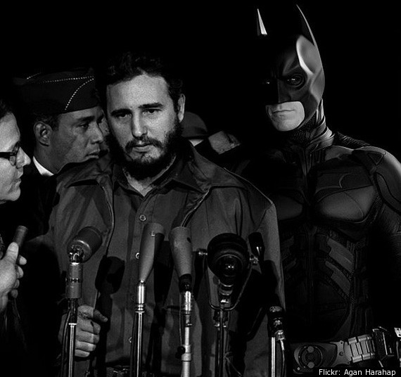
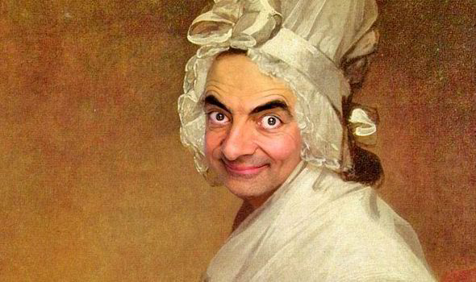
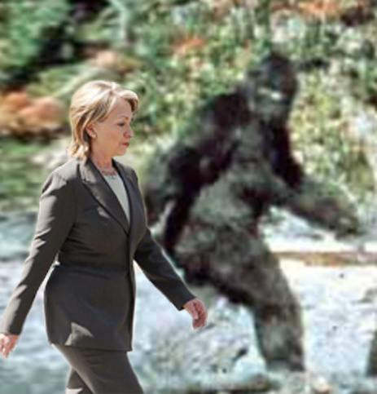
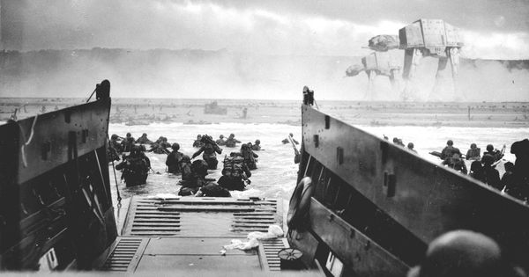
Why must we learn history?

Slide 4
Why must we learn history?
Look at the quotes at your table. What do they say about the importance of history? Discuss at your tables.
Take some time to come up with your own quote answering the question: Why must we learn history?
Share at your tables.

Slide 5
Chronological Thinking
Chronological thinking is the foundation of historical reasoning
The ability to examine relationships among historical events and to explain historical causality
Historical eras are fluid and historians may not agree on the ‘start and end dates’ of particular periods or eras in history

Slide 6
Chronological Thinking
Every historical era, period, or event has a temporal structure(beginning, middle, and end).
As history students you will:
Think forward from the beginning of an event, problem, or issue through its development, and anticipate some outcome.
Work backward from some issue, problem, or event in order to explain its origins or development over time.
Interpret and create timelines.

Slide 7
Chronological Thinking
Creating Timelines:
Creating Timelines Prezi

Slide 8
Historical Comprehension
Historical Passages vs. Historical Narratives:
Historical Passages- Primary sources that provide firsthand testimony or direct evidence concerning a topic under investigation.
Historical Narratives- Research based stories or accounts that describe or interpret historical events.

Slide 9
Historical Comprehension
Historical Passages
Historical Narratives
Read to reveal the humanity of the individuals and groups who lived in the past.
Their:
Motives
Intentions
Values
Ideas
Hopes
Doubts
Fears
Strengths
Weaknesses
Requires the appreciation for historical perspective
Judge the past by considering the context in which the events unfolded without your own personal norms or values
Think about history from a different perspective.
Notes:
Analyze historical data and sources beyond written passages or narratives in order to clarify, illustrate or elaborate on data presented in historical passages or narratives. This data includes, but is not limited to, visual, mathematical, and quantitative data presented in a variety of historical maps, graphic organizers, photographs, political cartoons, paintings, music and architecture.

Slide 10
Historical Analysis
Historical analysis involves a rich variety of historical documents and artifacts that present alternative voices, accounts, and interpretations or perspectives on the past.
Identify issues and problems in the past and analyze the interests, values, perspectives, and points of view of those involved in the situation.
Judge the past in consideration of the historical context in which the events unfolded and not solely in terms of personal and/or contemporary norms and values.
Analyze past events in terms of cause and effect relationships.

Slide 11
Historical Interpretation
The study of history is subject to an individual’s interpretation of past events, issues, and problems, and there is usually no one right answer, one essential fact, or one authoritative interpretation that can be used to explain the past.
Historians may differ on the facts they incorporate in the development of their narratives and disagree on how those facts are to be interpreted. Thus, written history is a “dialogue” among historians, not only about what happened but about the historical interpretation of why and how events unfolded.

Slide 12
Historical Interpretation
You will:
Consider multiple causes of past events by demonstrating the importance of the individual in history; the influence of ideas, human interests, and beliefs; and the role of chance, the accidental and the irrational.
Use specific criteria to critique competing historical interpretations of past events in order to differentiate between expressions of opinion and informed hypotheses grounded in historical evidence.
Use specific criteria to judge the relevance of the past to contemporary events and their own lives through a variety of classroom settings such as debates, simulations, and seminars.

Slide 13
Historical Research
Historical Inquiry:
The research or investigation of change over time, often begins with a historical question.
Process of studying history that includes questioning, forming hypotheses, analyzing evidence, and creating arguments in order to test hypotheses of past events.
Allows one to analyze preexisting interpretations, to raise new questions about an historical event, to investigate the perspectives of those whose voices do not appear in the textbook accounts, or to investigate an issue that the textbook largely or in part bypassed.

Slide 14
Historical Research
Primary vs. Secondary Resources:
https://youtu.be/cqXHO7bTPnw

